Slide 1
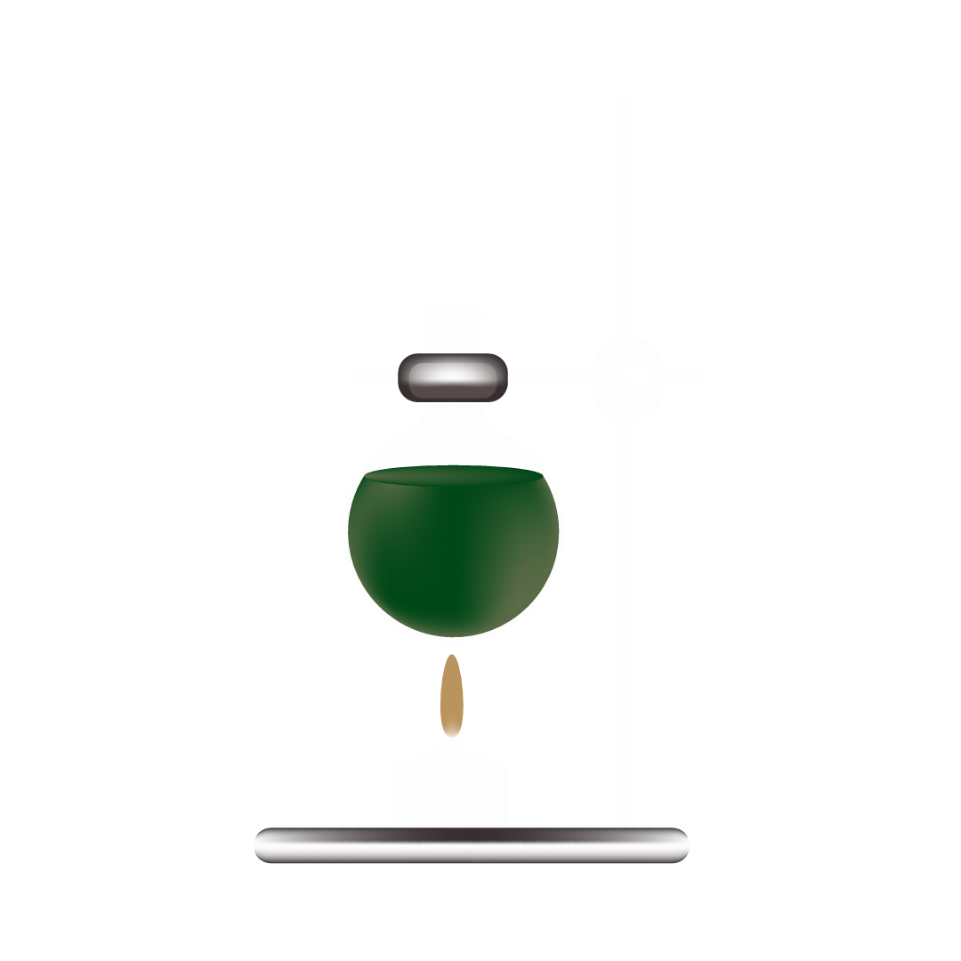

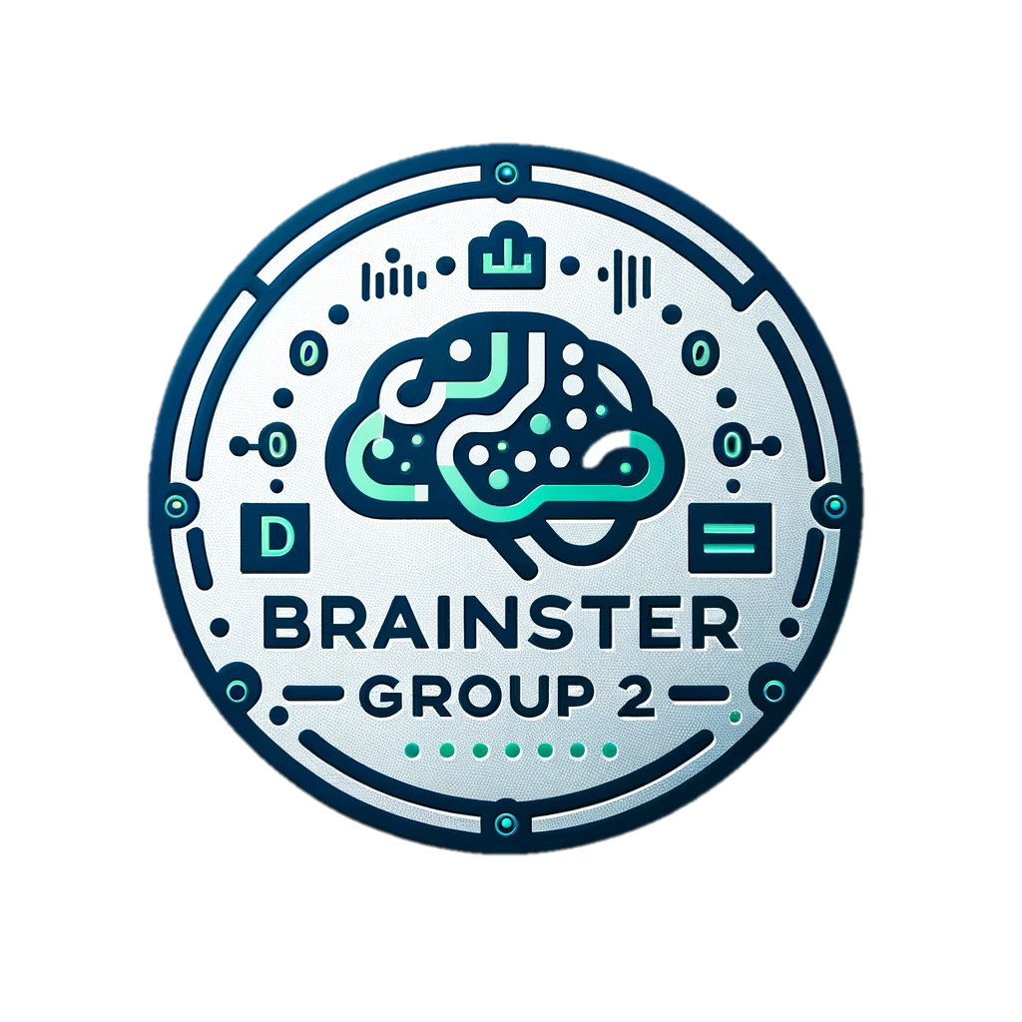

Advanced Ingredient Analysis and Integration for Kungul App
X

Slide 2
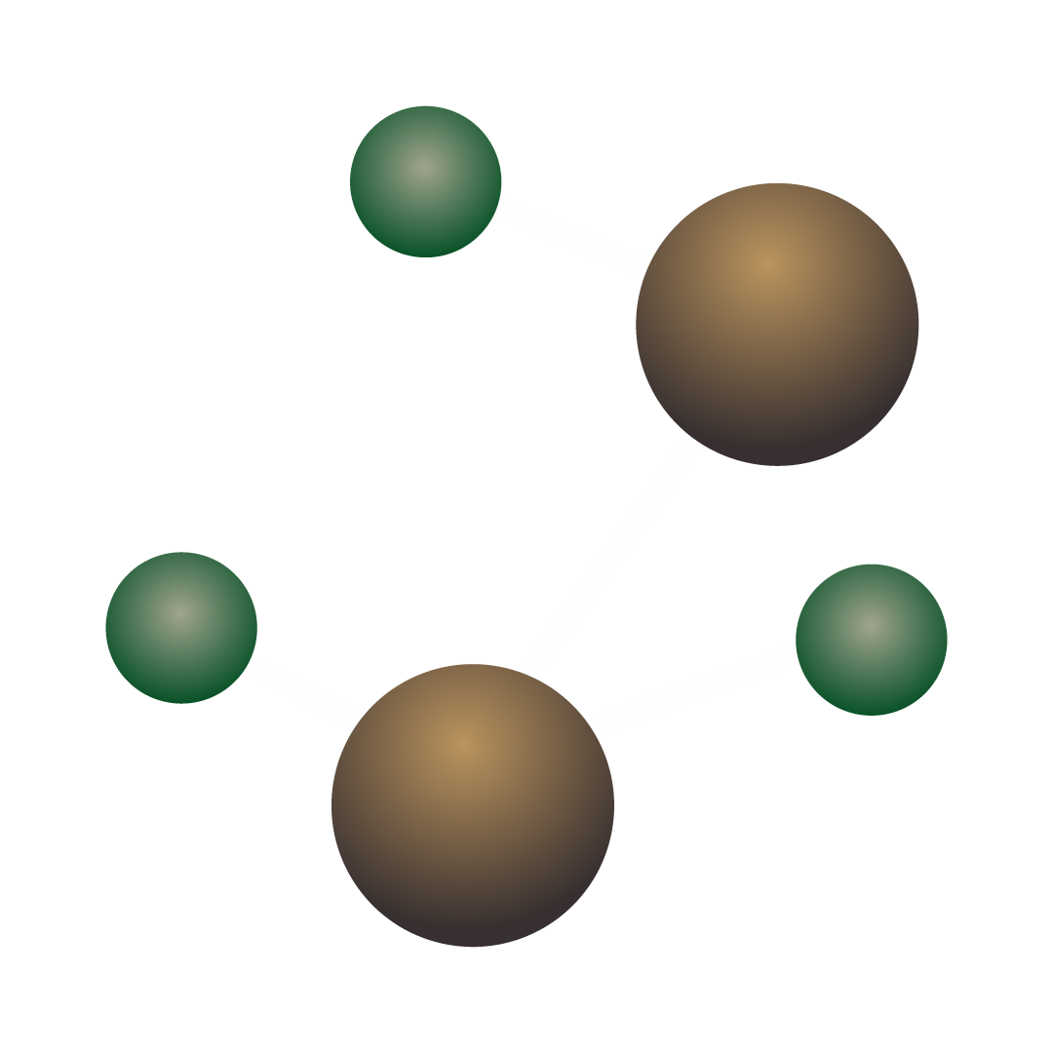
Project Scope: Enhancing Kungul's Ingredient Analysis Capabilities
Overview:
This project aims to augment Kungul's mobile application, which assists consumers in identifying harmful ingredients in skincare products. Leveraging advanced Natural Language Processing (NLP) and Optical Character Recognition (OCR) technologies, we enhance the app's ability to accurately analyze and match skincare ingredients against established harmful ingredient databases.
Objectives:
Enhance Ingredient Analysis Accuracy: Improve the app's ability to match and analyze ingredients using NLP methods.
Automate Ingredient Data Extraction: Utilize OCR technology to extract ingredient information from product labels, integrating this data with the existing system.
Align with Consumer Health Awareness: Strengthen Kungul’s mission of empowering consumers to make healthier self-care decisions.

Slide 3
Vesna Pop-Dimitrijoska
Tamara Jovanovska
Nikola Stankovski
Ivan Stojkovski
CEO
COO
CTO
x
/user name
/user name
/user name
/user name
@user name
@user name
@user name
@user name

Slide 4
Task 1 (Core):
a. Given a list of ingredients, match the ingredients that are the same by using methods
Task 1: Core NLP Ingredient Analysis
Subtask 1a: Ingredient Matching
Describe the NLP methods and language resources that will be used to match ingredients.
Explain the technical approach, such as text normalization, similarity scoring, etc.
Challenges and Solutions
Identify potential challenges in implementing these tasks.
Propose solutions or approaches to overcome these challenges. Results Display:
Show before-and-after examples of ingredient lists and how they were matched.
Include visuals like matched pairs, highlighting similarities.
Methodology Overview:
Briefly recap the NLP techniques used (e.g., text normalization, similarity algorithms).
Explain any challenges encountered and how they were resolved.

Slide 5
Task 1 (Core):
b. Given a list of products along with ingredient lists for each, split the ingredients
accordingly and match them using NLP methods with the ingredients from task 1-a.
Subtask 1b: Product-Based Ingredient Analysis
Discuss how you'll process lists of products and their ingredients.
Outline the method for splitting ingredients and matching them using NLP.
Challenges and Solutions
Identify potential challenges in implementing these tasks.
Propose solutions or approaches to overcome these challenges. Results Display:
Present a case study of a product, showing its ingredient list and the matching process.
Use charts or tables to demonstrate the ingredient breakdown and matching.
Methodology Overview:
Discuss the process of splitting and matching ingredients.
Highlight any unique solutions developed for this task.

Slide 6
Task 2 (Supplementary):
Given photographs of various products’ ingredient labels, extract the text with a Python OCR
library and use the solution from Task 1 to match the ingredients..
Task 2: Supplementary OCR Ingredient Extraction
Explain the use of a Python OCR library to extract ingredients from product labels.
Discuss how the extracted text will be processed using the solutions developed in Task 1.
Mention any challenges, like varying label formats, and how you plan to address them.
Challenges and Solutions
Identify potential challenges in implementing these tasks.
Propose solutions or approaches to overcome these challenges.
Results Display:
Show images of product labels before and after text extraction.
Present the extracted text and how it was integrated into the NLP system.
Methodology Overview:
Discuss the choice of Python OCR library and its effectiveness.
Address any OCR-specific challenges, like image quality or font variations.

Slide 7
Strategies that not only engage users but also add real value to their experience.
Future Enhancements
Potential future enhancements or areas of further collaboration
Gamification of Skincare Journey
Reward and Loyalty Program
Feature: Introduce game-like elements such as challenges, progress tracking, and rewards to make the skincare journey engaging and fun.
Benefit: Transforms routine skincare into an interactive and rewarding experience, significantly boosting user engagement and app stickiness.
Feature: A comprehensive rewards system rewarding users for frequent app usage, successful referrals, and active participation in community features.
Benefit: Motivates ongoing user engagement and loyalty, while incentivizing new user acquisition through referral rewards.
Personalized Skincare Recommendations
Community Building
Feature: AI-driven, personalized skincare advice. Users receive routines and product suggestions based on their unique skin type, concerns, and preferences.
Benefit: Enhances user engagement by providing bespoke skincare advice, fostering regular app interaction and a personalized experience.
Feature: A dedicated in-app platform for users to share their skincare experiences, post reviews, and exchange tips and advice.
Benefit: Cultivates a supportive community atmosphere, increasing user retention and attracting new users through organic, word-of-mouth promotion.

Slide 8
Thank you!
Do you have any questions?

